Slide 1
Modeling Relation Paths for Representation Learning of Knowledge Bases
Yankai Lin, Zhiyuan Liu , Huanbo Luan , Maosong Sun , Siwei Rao , Song Liu
EMNLP 2015
Doyeon Lim
2018.07.19

Slide 2
Contents
Knowledge Graph Completion
Privious Work (TransE)
PtransE (path-based TransE) Approach
Relation Path Reliability
Relation Path Reptresentation
Experiments and Analysis (Knowledge Base Completion)
Entity Prediction
Relation Prediction
Case study

Slide 3
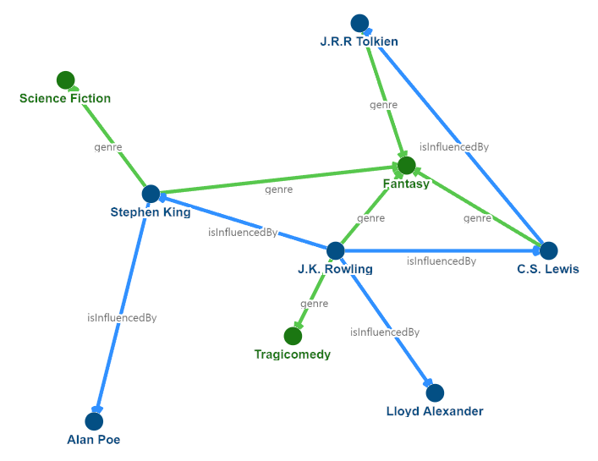
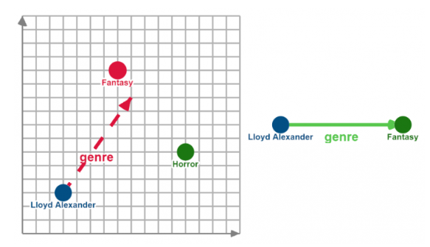
Knowledge Graph Completion
Complete the triple (h,r,t) when one of h, t, r is missing.

Slide 4
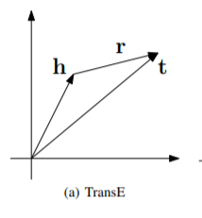
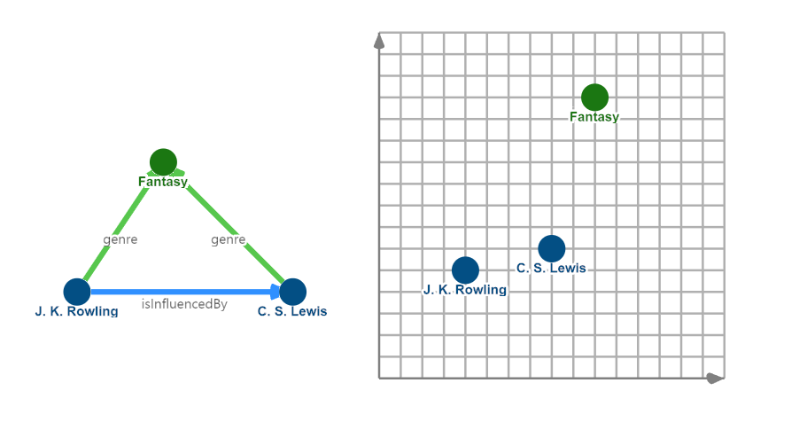

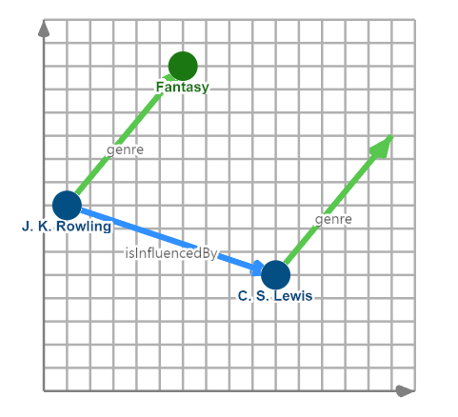
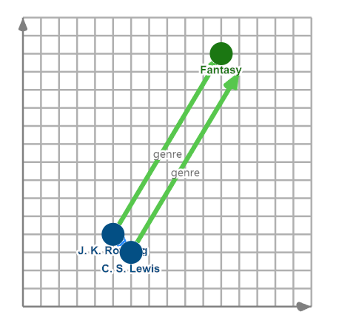
Privious Work (TransE)

Slide 5
PtransE (path-based TransE) Approach
Multiple-step relation paths also contain rich inference patterns between entities
e.g)
(h, Nationality, t)
Key challenges in PtransE
(1) Design a path-constraint resource allocation algorithm to measure the reliability of relation paths.
(2) Represent relation paths via semantic composition of relation embeddings

Slide 6
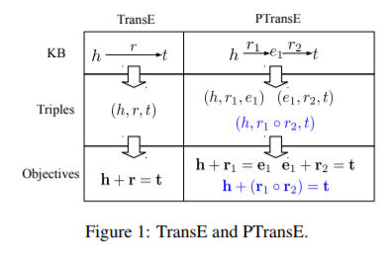

PtransE (path-based TransE) Approach
Relation Path Reliability
relation paths that lead to lots of possible tail entities are mostly unreliable for the entity pair
Relation Path Representation
Use binary operator ◦
p = r1 ◦ . . . ◦ rl
Notes:
does not indicate any semantic relationship between h and t

Slide 7


PtransE (path-based TransE) Approach transE and PtransE
Energy function
transE
PtransE
Relation Path Set between h and t
P(h, t) = {p1, . . . , pN }
Relation path Relability
Energy function for (h,p,t)
Normalize term
Z = P p∈P(h,t) R(p|h, t)
Notes:
does not indicate any semantic relationship between h and t

Slide 8







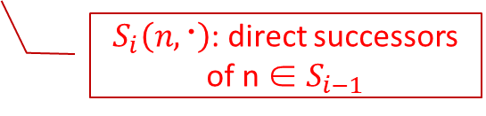
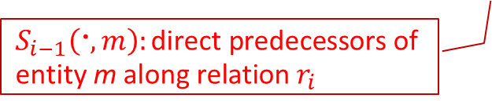
PtransE (path-based TransE) Approach Relation Path Reliability
path-constraint resource allocation (PCRA) algorithm
Path triple
Initial state
Resource flowing to m
$S_{i}\left(n,〮\right)$: direct successors of n ∈ $S_{i−1}$
$$S_{i−1}\left(〮,m\right):\text{direct} \text{predecessors} \text{of} \text{entity} \text{m} \text{along} \text{relation} r_{i}$$
relation paths that lead to lots of possible tail entities are mostly unreliable for the entity pair
Notes:
does not indicate any semantic relationship between h and t

Slide 9
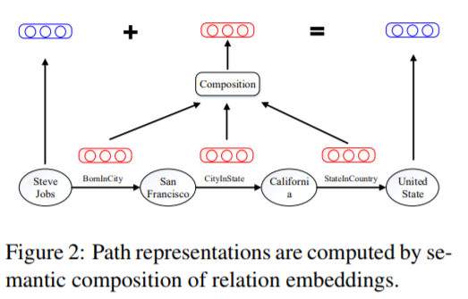
PtransE (path-based TransE) Approach Relation Path Representation
Addition (ADD)
Multiplication (MUL)
Recurrent Neural Network (RNN)
Notes:
does not indicate any semantic relationship between h and t

Slide 10


PtransE (path-based TransE) Approach Relation Path Representation
Addition (ADD)
Multiplication (MUL)
Recurrent Neural Network (RNN)
[a; b] :concatenation of two vectors
f: non-linearity function
Notes:
does not indicate any semantic relationship between h and t

Slide 11


PtransE (path-based TransE) Approach Relation Path Representation
Energy function
since
➔
Notes:
does not indicate any semantic relationship between h and t

Slide 12





PtransE (path-based TransE) Approach Objective Formulation
Objective
valid set
invalid set
Notes:
does not indicate any semantic relationship between h and t

Slide 13



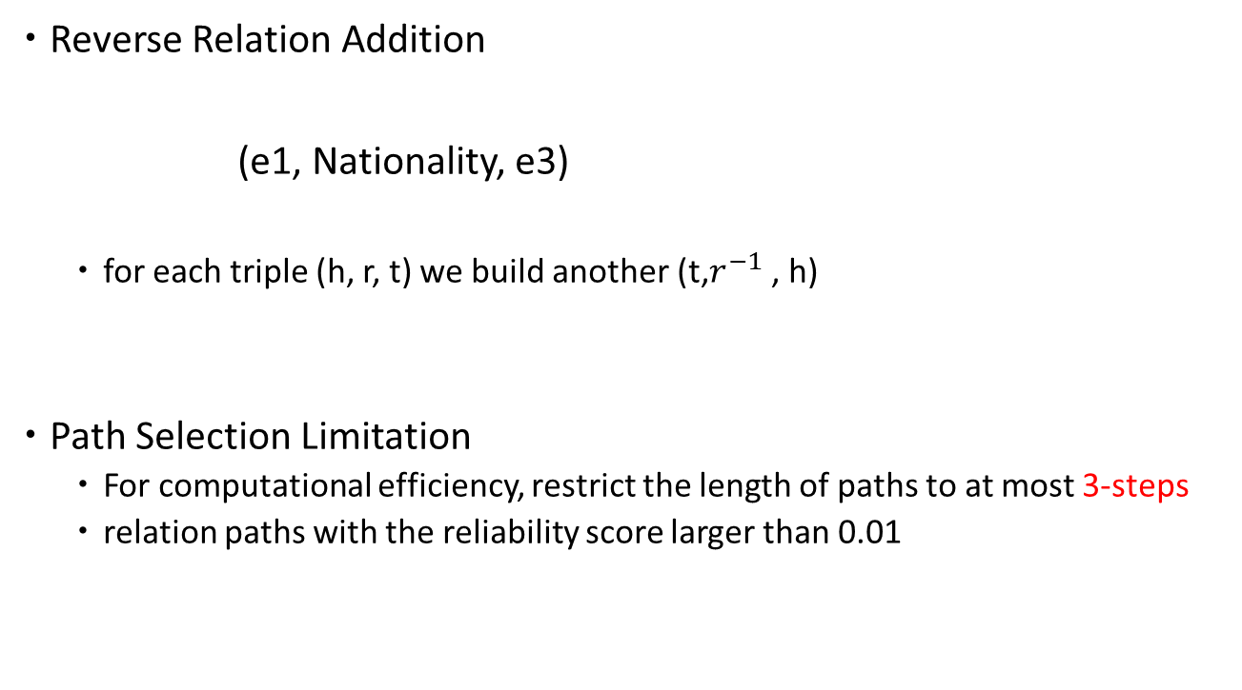
PtransE (path-based TransE) Approach Implementation Details
Reverse Relation Addition
(e1, Nationality, e3)
for each triple (h, r, t) we build another (t,$r^{−1}$ , h)
Path Selection Limitation
For computational efficiency, restrict the length of paths to at most 3-steps
relation paths with the reliability score larger than 0.01
Notes:
does not indicate any semantic relationship between h and t

Slide 14
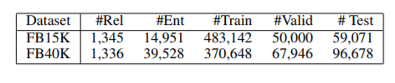
Experiments - Dataset
Notes:
abstract information
They have friendship between users, concerned topics

Slide 15

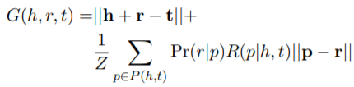
Experiments - Knowledge Base Completion
complete the triple (h, r, t) when one of h, t, r is missing
obtained from training set
Notes:
abstract information
They have friendship between users, concerned topics

Slide 16
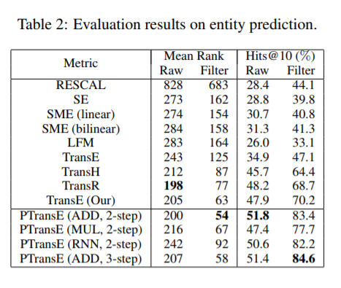
Results- Entity Prediction
G(h,r,t) is measured for all candidate entities and rank
Rank using TransE → re-rank with 500 candidates
Notes:
Obama (Lincoln) – PresidentOf - USA
(1) PTransE significantly and consistently outperforms other baselines including TransE. It indicates that relation paths provide a good supplement for representation learning of KBs, which have been successfully encoded by PTransE.
(2) For PTransE, the addition operation outperforms other composition operations
(3) PTransE of considering relation paths with at most 2-step and 3-step achieve comparable results

Slide 17
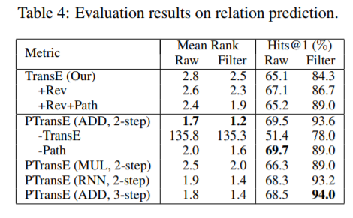
Result - Relation Prediction
Notes:
Lincoln may be regarded invalid for prediction, but in fact it is valid in KBs. The evaluation metrics will under-estimate those methods that rank these triples high. Hence, we can filter out all these valid triples in KBs before ranking. The first evaluation setting was named as “Raw” and the second one as “Filter”.

Slide 18
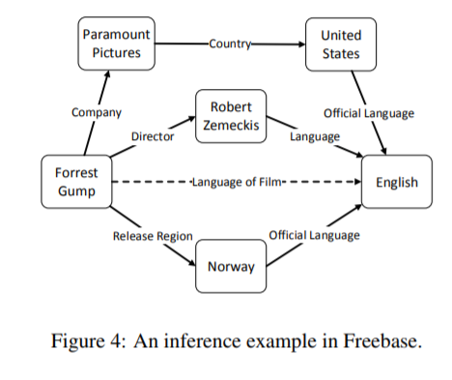
Result – Case study
Notes:
all these key elements in A can find corresponding words in B and C. It’s intuitive that these key elements give an exact explanation of the citation relations

Slide 19
Conclusion
novel representation learning method for KBs, which encodes relation paths to embed both entities and relations in a low-dimensional space
propose path-constraint resource allocation to measure relation path reliability
Future work
This paper only considers the inference patterns between direct relations and relation paths between two entities for learning e.g) Queen → Female
Notes:
친구, 가족 등등

